Slide 1
TXTIMONY:
Bearing Witness To Crises Via Data Journalism
Beri E. Ndifon

Slide 2
ISSUE CONTEXT: CIVIL LIBERTIES
Civilians are collateral damage at best and deliberate targets at worst in violent conflicts between state and non-state political actors globally.
Cameroon
Nigeria
Both government and separatist forces are killing civilians, inadvertently in some cases (stray gunfire during exchanges) and ruthlessly in others (executions based on suspicions of aiding/harboring either side). The death toll since the crisis erupted in 2016 is mounting but remains unknown.
More than 2.3 million have been displaced since 2015, hundreds have been abducted (most notably 276 high school students from Chibok in Borno State in 2014), and the precise death toll is unknown but estimated to have reached the tens of thousands since the current insurgency began in 2009.
Notes:
Ambazonian Separatist Movement’s Timeline:
Late 2016: Local lawyers and teachers mobilized over demands for respect of the region’s Anglophone educational and judicial systems and an end to Anglophone marginalization. Escalated into armed confrontations following government security forces’ repression of the mass protests that ensued.
Early 2017: Cameroonian government negotiated with lawyers and teachers’ unions, but its security forces arrested two prominent negotiators on January 17.
Late 2017: Anglophones in diaspora formed an interim government for the self-declared Republic of Ambazonia, comprised of the Northwest and Southwest regions, and called for more mass protests. The separatist movement has since splintered into factions, some of which have become extremely violent.
Boko Haram Insurgency’s Timeline:
Mid-2009: Boko Haram staged an uprising and killed nearly 1,000 soldiers throughout northern Nigeria, beginning the insurgency. Boko Haram was founded in Maiduguri in Borno State; it aims to eradicate Western influence from and create an Islamic state in Northern Nigeria, governed by Sharia law.

Slide 3
ISSUE CONTEXT: PRESS FREEDOM
Governments’ systematic censorship or outright suppression of domestic and international journalism creates accountability and information vacuums that sustain social oblivion beyond regional or national borders. This in turn emboldens the most horrifically inhumane inclinations of both factions.
Cameroon
Nigeria
Ranks 129th in the world according to Reporters Without Borders’ 2018 global press freedom index.
Journalists routinely face arrest, torture, and legal prosecution for defamation culminating in lengthy prison terms and exorbitant fines.
The government sporadically blocks internet access in the Anglophone Northwest and Southwest regions.
Ranks 119th in the world according to Reporters Without Borders’ 2018 global press freedom index.
Journalists are routinely refused information access and face threats and/or physical violence when undeterred.
There are still more than 100 independent media outlets. Online freedom was recently curbed by a cyber-crime law that arbitrarily penalizes bloggers.
Notes:
Issa Tchiroma Bakary, the Minister of Communication, claims that press freedom is guaranteed “as long as it is consonant with the defense of institutions.”
Cameroonians (both in the country and in diaspora) rely on independent online journalism to produce the news they consume. The government owns the only national newspaper, the public television station, and the public radio stations. Private radio and television broadcasting licenses are either indefinitely “under review” or selectively granted contingent on non-critical coverage.

Slide 4
ISSUE CONTEXT: RESPONSIBLE GOVERNANCE
The resulting escalation cycle only tends to be disrupted or at least exposed when important economic and political interests are impacted significantly enough that the powers concerned actively or passively intervene.
Cameroon
Nigeria
The recent murder of Charles Wesco, an American missionary, elicited international coverage and remarks from Indiana’s governor and Congressional representatives.
American and European diplomats and politicians congratulated the incumbent president on securing his 6th 7-year term at 85 without addressing the crisis.
The insurgency’s territorialization (it has spread into Cameroon, Chad, and Niger), affiliation with ISIS, and growing resilience against the Multinational Joint Task Force (MNJTF) and USAFRICOM are much more concerning.
Nigeria is Africa’s most populous country and a key target of both American and European economic statecraft.
Notes:
The Multinational Joint Task Force (MNJTF) is a combined multinational formation, comprising units, mostly military, from Benin, Cameroon, Chad, Niger, and Nigeria.

Slide 5


DATA PRODUCT: TXTIMONY
A text-powered crisis monitor built on the Ushahidi platform: the latter collects and visualizes data about incoming real-time civilian reports, while the former extracts topics from them and uses word relationships to characterize the crises.
Anonymity & Democratization: Real-time reporting is accelerated and attribution-based retaliation is impossible; transforms the news production process. |  | Digital Censorship: The ability to circumvent web and mobile network blocks would pose an accessibility challenge.
Force-Multiplication: Leveraging the agency of courageous civilians to diminish reliance on journalistic coverage and the news cycle. |  | Data Veracity: Identifying and filtering out duplicative reports and deliberate disinformation would need to be a priority.
The minimum viable product I’ve developed is capable of extracting topics that describe Cameroon’s Ambazonian separatist movement and Nigeria’s Boko Haram insurgency.
These crises are geographically and temporally concurrent: Cameroon and Nigeria border each other, collaborate diplomatically and militarily, as well as harbor each others’ refugees.
Notes:
The Ushahidi platform was created in 2008 to crowdsource and map data post-election violence in Kenya and has since become an enterprise data collection, management, and visualization solution for citizen engagement, election monitoring, humanitarian aid, incident management, and other operations.
Digital Censorship: Chinese college students have devised a novel approach that might also be applicable here - embedding messages in Blockchain transaction descriptions.
Data Veracity: Applying Artificial Intelligence to combatting the latter is still a nascent effort - a startup called Factmata is currently tackling this challenge.

Slide 6
DEVELOPMENT WORKFLOW:
ACLED API Query
Source Scraping
Ruby Web Service
Data Cleaning Pt. I
Pandas
Source Identification
Soup Making
Output:
Beautiful Soup
Output:
Action(s):
Action(s):
Action(s):
Action(s):
Retrieved a year of Cameroonian and Nigerian conflict data (09/01/2017 to 09/01/2018).
Identified scrapable domestic sources.
Target Sources
Output:
.JSON File: Target Sources, Search Terms, & Links
Enlisted Aurora Hampton’s assistance with scraping those target sources.
Dropped duplicate links.
Created a dataframe from the .JSON file.
Soup Ingredients
Parsed each target source’s links for articles (documents); stored them as lists.
Converted them into series; concatenated and then realigned them to search terms and links.
Output:
Raw Dataset
Part I
Data Cleaning Pt. II
Parameter Optimization
SKLearn
Topic Modeling
SKLearn
Model Evaluation
Output:
Output:
SKLearn
Pandas
Action(s):
Action(s):
Action(s):
Action(s):
Filtered HTML and JavaScript residue.
Dropped irrelevant and truncated documents as well as duplicates (both within and across target sources).
Lowercased documents; filtered nonalphabetic characters.
Clean Dataset
Grid-searched the vectorizer’s min_df and max_df, as well as the initial model’s n_topics.
Defined custom stop-words based on initial model runs.
Split the dataset into training and test sets; stratified on search term.
Optimal Parameters
Vectorized training and test sets using the optimal min_df and max_df.
Fit models to the TFIDF matrices using the optimal n_topics and quantile-scaled the scores.
Model Outcomes
Output:
Inspected training and test sets’ loading distributions per topic by model.
Aligned scores and topic assignments to documents.
Inspected documents’ topic distributions.
Calculated confusion matrices and Type I/II error rates using search term as a class label.
Inspected top words per topic by model.
Part II
Notes:
The Armed Conflict Location & Event Data (ACLED) project is one of the most credible free and open providers of real-time data for analyzing and visualizing political violence in the developing world. It's primarily powered by reports from domestic and international news outlets, supplemented by local sources who tend to cover farther-flung locations.
I initially identified 14 target sources, of which only 8 were scrapable and returned 290 article links as soup ingredients. After making soup from the links and cleaning the first time, the resulting raw dataset dropped down to 208 documents. After cleaning the second time, my final modeling dataset dropped down to 102 documents.

Slide 7
KEY CHALLENGES & CHOICES:
Dynamic Data’s Inaccessibility
The lead times for social media API access were a constraint: static sources were my only alternative.
Topic Modeling Approach
Abstraction could be more powerful than extraction, but I didn’t implement it because it’s beyond my current skillset.
Document Lemmatization
I was focused on relationships not summarization, so I chose not to stem: it would’ve improved recall at the expense of precision.
Model Performance Evaluation
I used confusion matrices and Type I/II error rates instead of coherence, log likelihood, or perplexity scores.
I used domestic sources (mostly Nigerian) as a proxy for civilian reports: markup inconsistencies and redundant articles shrank my data yield.
Source Scraping
Quantile-Based Scaling
I transformed model-fitting outcomes to minimize the impact of outliers and make visual interpretation easier.
Challenge
Choice

Slide 8
LATENT DIRICHLET ALLOCATION:
Generative model that makes inferences about the latent (unobservable) topic structure of a corpus given known words and documents.
Posits that each document is a mixture of topics and each word's presence is attributable to one of the document's topics.
Iteratively compares a document to two topics and determines which topic is closer to the document across all combinations of seemingly relevant topics.
Generally considered to be the most consistent at identifying coherent topics.

Slide 9
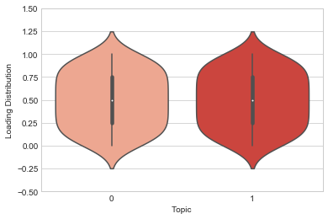
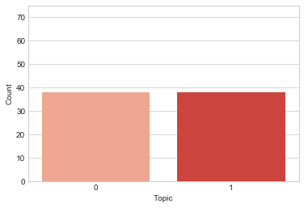
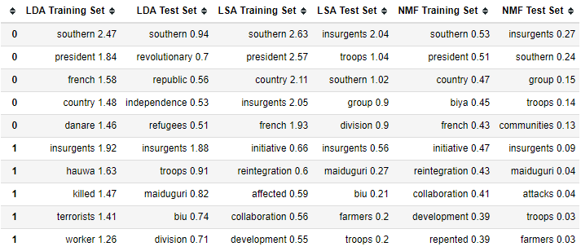
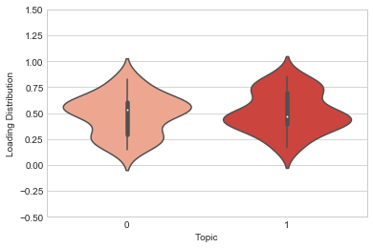
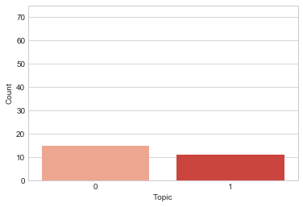
LDA OUTCOMES: Topic 0 = Cameroon’s Ambazonian Separatist Movement Topic 1 = Nigeria’s Boko Haram Insurgency
Training Set
Top Words Per Topic
Test Set

Slide 10
LATENT SEMANTIC ANALYSIS:
Distributional model that applies Singular Value Decomposition (SVD) rather than Principal Components Analysis (PCA) to a TFIDF matrix to avoid losing sparsity.
SVD: Factorizes a real or complex matrix to create dense low-dimensional vectors for each word.
PCA: Orthogonally transforms possibly correlated variables into linearly uncorrelated and mean-centered variables.
Produces word clusters to reflect latent (unobservable) topic structure, assigning each document a score for each topic, with higher scores indicating that the document is more relevant to a topic.
Notes:
Term frequency–inverse document frequency is a statistic that reflects how important a word is to a document in a corpus.

Slide 11

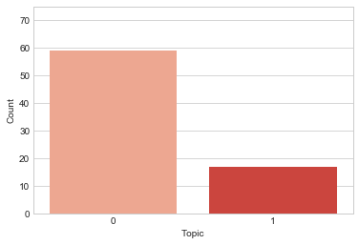
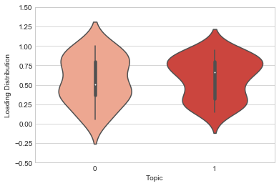
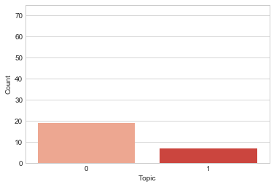
LSA OUTCOMES: Topic 0 = Cameroon’s Ambazonian Separatist Movement Topic 1 = Nigeria’s Boko Haram Insurgency
Training Set
Top Words Per Topic
Test Set

Slide 12
NON-NEGATIVE MATRIX FACTORIZATION:
Decomposition model that factorizes a TFIDF matrix into non-negative (and consequently easier to inspect) document-topic and topic-word matrices.
Represents each document as a weighted sum of its comprising topics.
Naturally produces sparse representations because it has inherent clustering properties.

Slide 13
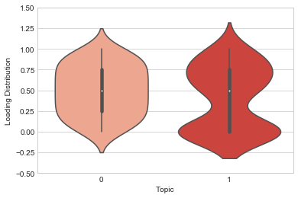
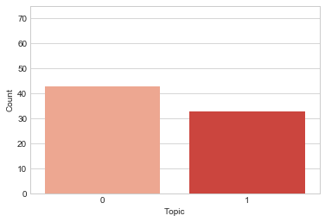
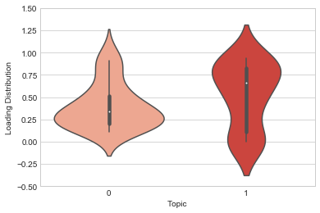
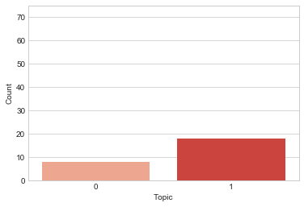
NMF OUTCOMES: Topic 0 = Cameroon’s Ambazonian Separatist Movement Topic 1 = Nigeria’s Boko Haram Insurgency
Training Set
Top Words Per Topic
Test Set

Slide 14
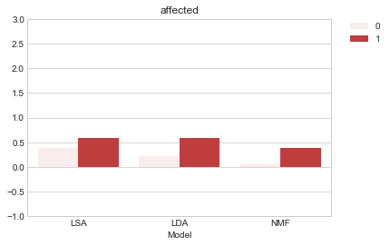
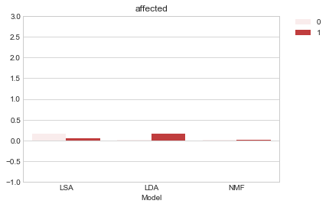
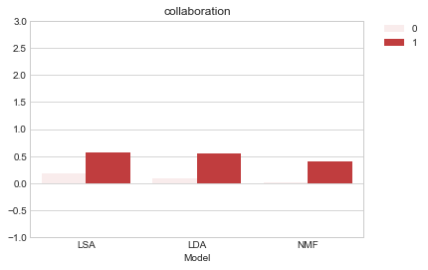
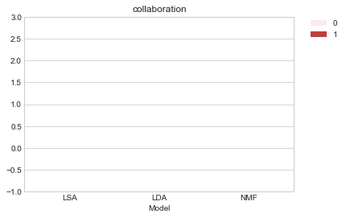
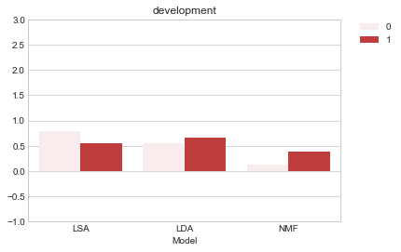
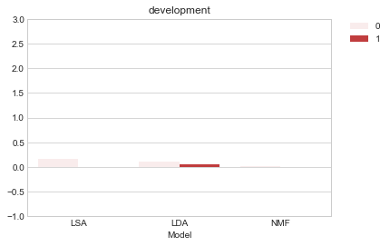
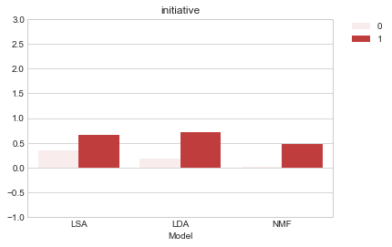
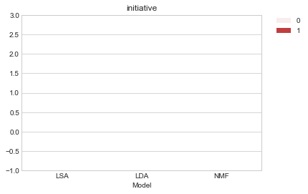
TOP WORDS & LOADINGS - SPARSITY: I
There were 29 unique top words associated with either or both of the topics.
These 12 were exclusively associated with Cameroon’s Ambazonian separatist movement:
These 14 were exclusively associated with Nigeria’s Boko Haram insurgency:
These 3 were associated with both:
I validated the inferences I’d made about 6 words’ topic associations by inspecting their prevalence in the training and test sets by search term as well as their loadings.
biya | french | refugees
communities | group | republic
country | independence | revolutionary
danare | president | southern
affected | farmers | reintegration
attacks | hauwa | repented
biu | initiative | terrorists
collaboration | killed | worker
development | maiduguri
division | insurgents | troops
Notes:
It makes sense that loadings are sparser for the test sets given their size (25% of a very small dataset).

Slide 15
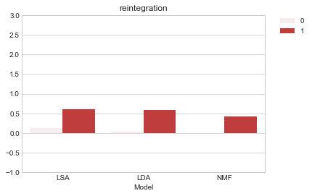



TOP WORDS & LOADINGS - SPARSITY: II
There were 29 unique top words associated with either or both of the topics.
These 12 were exclusively associated with Cameroon’s Ambazonian separatist movement:
These 14 were exclusively associated with Nigeria’s Boko Haram insurgency:
These 3 were associated with both:
I validated the inferences I’d made about 6 words’ topic associations by inspecting their prevalence in the training and test sets by search term as well as their loadings.
biya | french | refugees
communities | group | republic
country | independence | revolutionary
danare | president | southern
affected | farmers | reintegration
attacks | hauwa | repented
biu | initiative | terrorists
collaboration | killed | worker
development | maiduguri
division | insurgents | troops
Notes:
It makes sense that loadings are sparser for the test sets given their size (25% of a very small dataset).

Slide 16
PERFORMANCE IN CONTEXT:
Because ‘Search Term’ was effectively a class label, class balance could have and did impact model performance measured in terms of misclassifications (Type I and II error).
The models were still undirected in finding a basis for meaningful differentiation between documents: I partially defined custom stop-words to deter them from finding the obvious.
 | LDA |  | LSA |  | NMF
 | Training Set: | Test Set: | Training Set: | Test Set: | Training Set: | Test Set:
‘Search Term’ Class Balance: | Good | Fair | Poor | Poor | Fair | Poor
Type I Error Rate: | 14.71% | 9.09% | 0.00% | 0.00% | 23.53% | 54.55%
Type II Error Rate: | 21.43% | 33.33% | 59.22% | 53.33% | 40.48% | 20.00%

Slide 17
KEY LEARNINGS:
Domain knowledge is a crucial input to the modeling process.
Deficient data can still produce valuable insights.
NEXT STEPS:
Acquiring dynamic data and enforcing class balance.
Building a robust preprocessing and modeling pipeline.
Extracting geographic and temporal relations.
Leveraging neural networks to implement and compare an abstractive approach.

